Slide 1
Cef 440: internet programming (j2ee) and mobile programming
PROJECT TITLE:
DESIGN AND IMPLEMENTATION OF A MARKET
MANAGEMENT SYSTEM

Slide 2
GROUP MEMBERS
GAMUAH PADJINOU RYANE JOY FE20A044
NDALEGH NOELA LUM MBAH FE20A070
FORMASIT CHIJOH FOKUNANG FE20A041
RACHEAL NKONGHO TAFONGOH FE20A100
MOSONGO ADINA SAKWE NANGERI FE20A066

Slide 3

TABLE OF CONTENT
INTRODUCTION
DISTRIBUTION OF SHOPS
PROJECT DESCRIPTION
PROJECT REQUIREMENTS
SYSTEM ACTORS
PRODUCT DESIGN

Slide 4
INTRODUCTION
PROBLEM STATEMENT
With the increasing size of markets and the increasing number of shops, it becomes difficult for buyers to locate shops with the products they are looking for, at the prices they are willing to pay. Furthermore, the vendors tend to lose potential clients.

Slide 5



PROJECT OBJECTIVES
This project seeks to bring the buyers and vendors closer by orienting the buyers to shops where they can find the product they are looking for.

Slide 6

PROPOSED SOLUTION
With the stated objectives in mind, the following are proposals to achieving them:
A mobile application can be developed to help vendors advertise their products.
The buyers will be able to locate shops.
The buyers will be able to get in contact with the vendors through the details which the application provides.

Slide 7
DISTRIBUTION OF SHOPS
SHOPS
SHOPS
SHOPS
SHOPS
Each of the spheres represent markets, and as indicated each market has several shops. This presents the buyers with a variety of options.

Slide 8
PROJECT DESCRIPTION
The application aims at improving sales and recognition for vendors and increase the ease of shopping for buyers. The application helps both buyers and sellers in the following way:
The buyers are aware of the availability of specific products with their respective prices in different shops.
The sellers can attract a huge market and advertise their products.

Slide 9
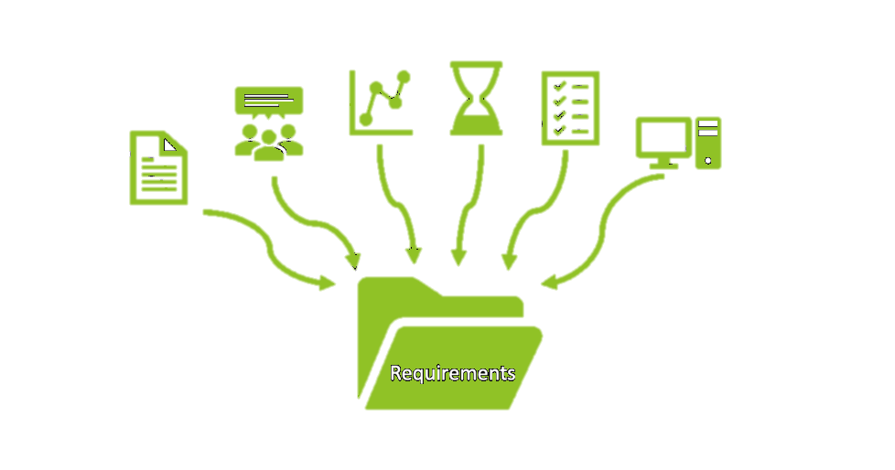
PROJECT REQUIREMENTS
FUNCTIONAL REQUIREMENTS
The buyers should be able to view available products, their prices and location of products in order to proceed to take decisions on how to proceed with their purchase.
The sellers should be able to upload the list of products on the application and their respective prices.
Buyers should be able to give feedback or rate shops, in other to help sellers identify loopholes.

Slide 10
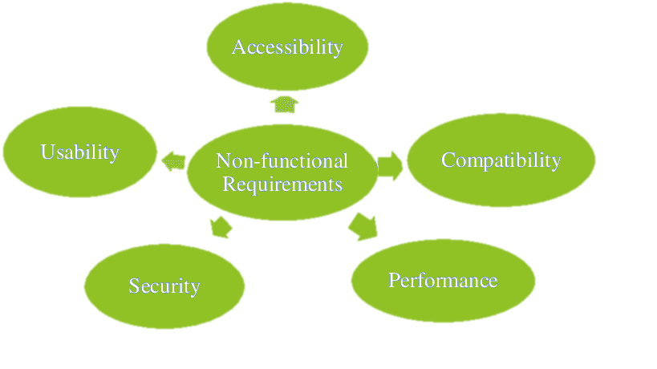
NON-FUNCTIONAL REQUIREMENTS
Performance
The system should be able to support high traffic even at peak market hours and function reliably.
Security
Customer and vendor data should be protected from unauthorized access.
Usability
The system should be easy and intuitive to use.

Slide 11
Integrity
The user information and credentials should not be consistent over the entire time when it will be needed.
Scalability
The application should be able to accommodate as many users without reducing its performance.
Compatibility
The application should be able to run on various platforms.
Hardware
The hardware devices on which the application could run, as well as those to build it should also be considered.

Slide 12
USERS
The main actors in the system are the buyers and vendors.
1. BUYERS
The buyers can carry out the following activities:
View the list of available items in the market.
Check the average prices of products in the market.
Search for a particular product to get the prices in different shops.
Rate the shops for feedback.

Slide 13
2. SELLERS
They can perform carry out the following activities:
They register their stands or shops on the platform.
They can add the products they sell with their characteristics (such as type , status and price).
They can promote their products through discounts therefore attracting potential customers to make their business known.
They are able to update their product status.

Slide 14

PRODUCT DESIGN
APPLICATION TYPE
The application to be built is a hybrid application for the following reasons:
It uses a single codebase and can easily be scaled for other platforms.
It is written in a web programming language, making resources easier to use. The application can use the devices’ internal features as they have a native application shell, which helps to improve on user experience.

Slide 15


TECHNOLOGY
This refers to the software packages and systems used by the industry for software analysis, development and security.
PROGRAMMING LANGUAGES AND FRAMEWORKS
The programming languages that will be used for this application are JAVASCRIPT, PHP and PYTHON.
The frameworks that will be used are REACT NATIVE and LARAVEL

Slide 16
THANK YOU!

